Slide 1
Molecular Biology Biol 480
Lecture 9 February 1st , 2019

Slide 2
Announcements/Assignments
Exam 1 ---Monday Feb. 4th.
Lab notebooks turned in Friday, Feb. 8th.
Labs 1,2,3
Lab 3 posted—Analyzing pGLO plasmid.
Schedule for doing the lab before Wednesday?

Slide 3
Where were we…
Histone and DNA modifications
The effect on DNA condensation and gene expression.
The modifications are reversible, but also heritable—some remain during mitosis and meiosis
Heterochromatin vs. euchromatin

Slide 4
Modifications of DNA
Interestingly---methylation of DNA is linked to gene expression inhibition, whereas methylation of histones is loosely associated with active genes.
DNA methylation is the mechanism behind genetic imprinting.

Slide 6
https://en.wikipedia.org/wiki/Genomic_imprinting
Genomic/genetic imprinting is an epigenetic phenomenon in which alleles of genes are inactivated by methylation (of DNA or histones) during egg OR sperm formation.
It is a parent-specific phenomenon. Some imprinting occurs in males. Some in females.
It is reversible.

Slide 7
Pages 94-95

Slide 8
Euchromatin and heterochromatin were first recognized when chromosomes were stained with a compound called Giemsa.
Until the 1970s techniques to stain chromosomes allowed one to see chromosomes, but showed more or less uniform staining of each chromosome in a cell

Slide 9
Methods were developed to treat the chromosomes with chemicals and or heat to allow differential uptake of giemsa stain.
These methods provided visible bands/stripes along the length of chromosomes, allowing identification of individual chromosomes.

Slide 10
Figures 12-11, 12, 13
Variations of staining methods (look these up)
C-banding
G-banding
R-banding
Q-banding

Slide 11
C-banding (binds only to centromere sequences)

Slide 12
G (giemsa)-banding with schematic
ajdlfjlf

Slide 13
R (reverse)-banding next to G-banding

Slide 14
In all banding techniques, where bands appear, there are differences in packing of the DNA.
Now bands are the primary way cytogenetics identify parts of chromosomes.

Slide 17
Let’s return to DNA, concentrating more on nucleotide sequence than on chromatin structure.
Recall that eukaryotic chromosomes are a combination of unique (single copy) and repetitive DNA

Slide 18
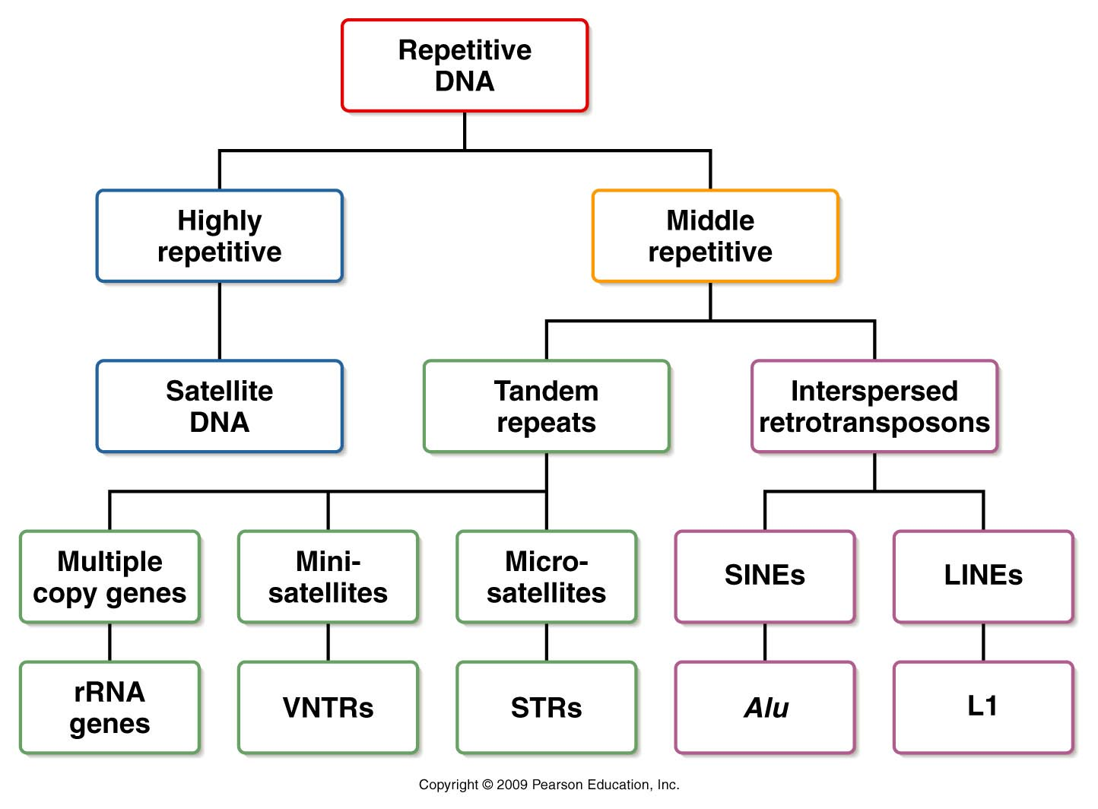
Figure 12.14
Notes:
Figure 12-14 An overview of the various categories of repetitive DNA.

Slide 19
Sedimentation analysis of DNA from mammals shows 2 main populations.
A bigger (more dense) population of DNA (Called main band---due to its relative size in a sedimentation tube.)
A smaller (less dense) population of DNA
This smaller population of DNA sequence has been termed satellite DNA.

Slide 20
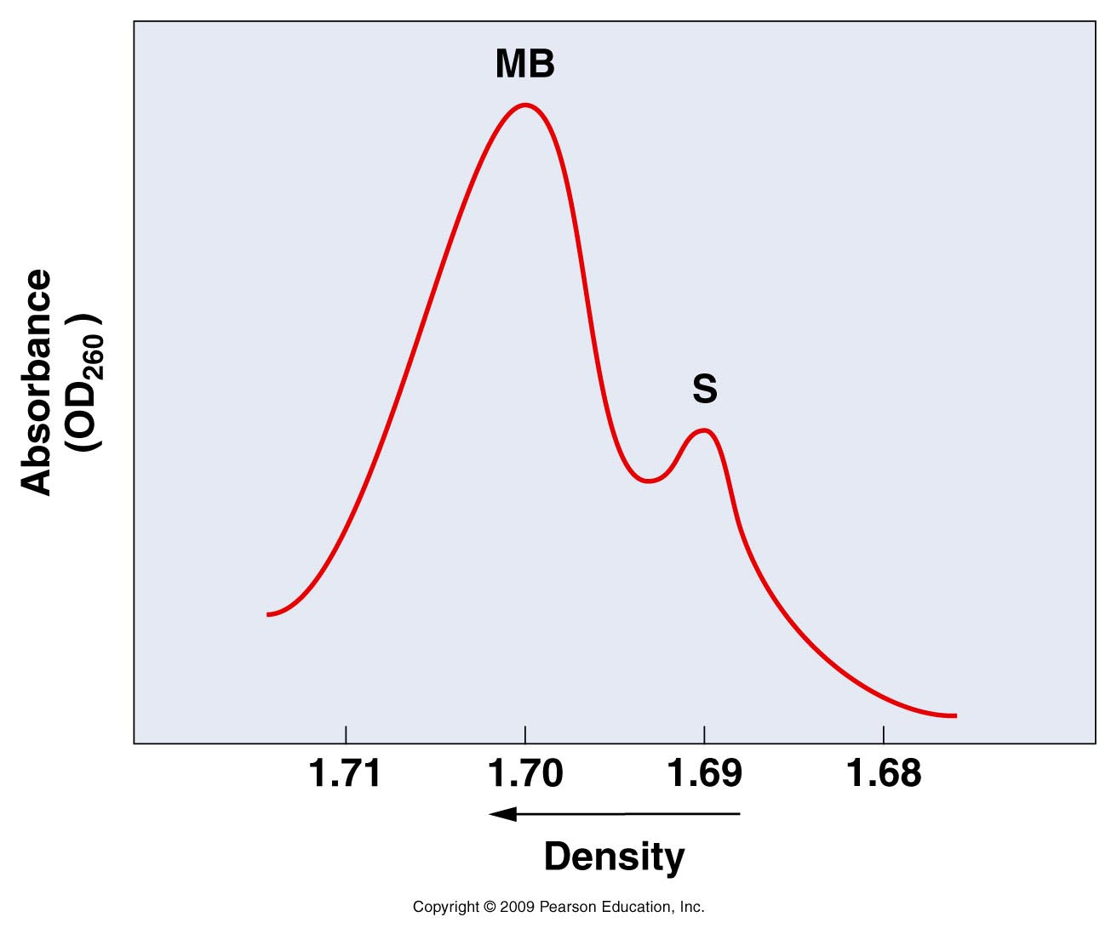
Figure 12.14
Notes:
Figure 12-14 An overview of the various categories of repetitive DNA.

Slide 21
Density of DNA will depend on A,G,T,C distribution.
The majority of our DNA has a consistent distribution, and an average density.
Repetitive DNA will skew the distribution and thus the density away from the average.

Slide 22
In situ hybridization shows that much of this “satellite DNA” is located at the centromeres of chromosomes in mammals.
Humans have ~ 170 bp tandem repeats in their centromeres—so-called α-repeats, that can make up up to 1 million bp.

Slide 23
What kind of experiment is this?

Slide 24
Although repetitive (satellite) DNA does not encode proteins, the CEN repeats are likely transcribed into RNA.
This RNA is likely important in distribution of chromosomes during mitosis.

Slide 25
These tandem repeats are tightly packed into heterochromatin but are essential in binding proteins that make up the kinetochore structure which binds to spindle fibers in mitosis.

Slide 27
Although the sequence is not exactly the same centromeres of all eukaryotic organisms, there are similarities that allow determination of a consensus sequence.

Slide 28
Figure 12.17
Notes:
Figure 12-17 Nucleotide sequence information derived from DNA of the three major centromere regions of yeast chromosomes 3, 4, 6, and 11.

Slide 29
Telomeres
Telomeres are also composed of repetitive DNA—a so-called telomere repeat, that is similar in all eukaryotes.
Human telomere repeat =TTAGGGG
Telomeres can be repeated 100s-1000s or times.
Telomeres are added to the inherited portion of each chromosome by an enzyme called telomerase.

Slide 30
Recall from your reading…telomeres are heterochromatic and do not contain protein encoding genes.
However, RNA is transcribed from the telomere repeats.

Slide 31
This Telomere repeat-containing RNA( TERRA) serves as template for synthesis of more DNA repeats at the ends of chromosomes.
It is part of the enzyme, telomerase.
In addition TERRA becomes part of the heterochromatic telomere structure by facilitating methylation of Histone H3.

Slide 32
Independent Study
What are micro and mini-satellite sequences
How have they helped in development of DNA fingerprinting techniques?
How are LINEs and SINEs different? Why are they considered transposable genetic elements?
What are multi-copy genes? Why might we maintain multi-copy genes in our genome?

Slide 33
Back to Chapter 11 DNA replication and recombination
Recall that in Watson and Crick’s 1953 paper describing DNA structure, they conclude
“It has not escaped our notice that the specific (base) pairing we have postulated immediately suggests a possible copying mechanism for the genetic material.”

Slide 34
What did they notice?
Why didn’t they propose the mechanism in the same paper?
Who did support this hypothesis of Watson and Crick?

Slide 35
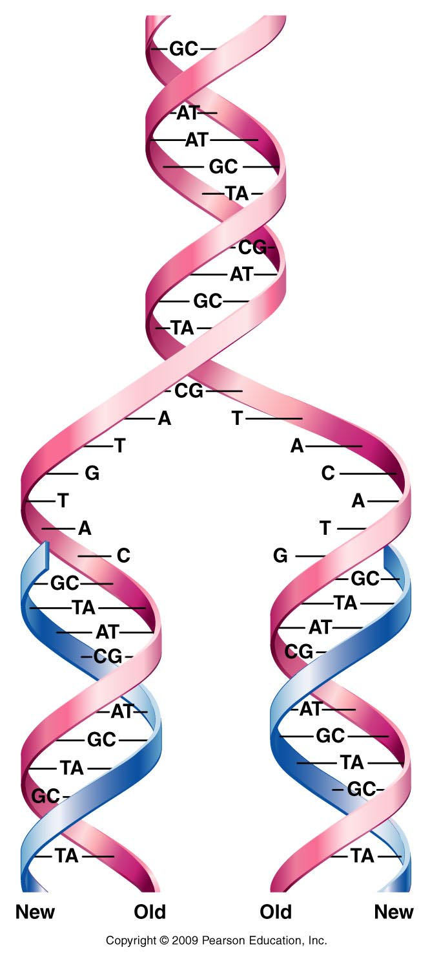
Figure 11.1
Notes:
Figure 11-1 Generalized model of semiconservative replication of DNA. New synthesis is shown in blue.

Slide 36
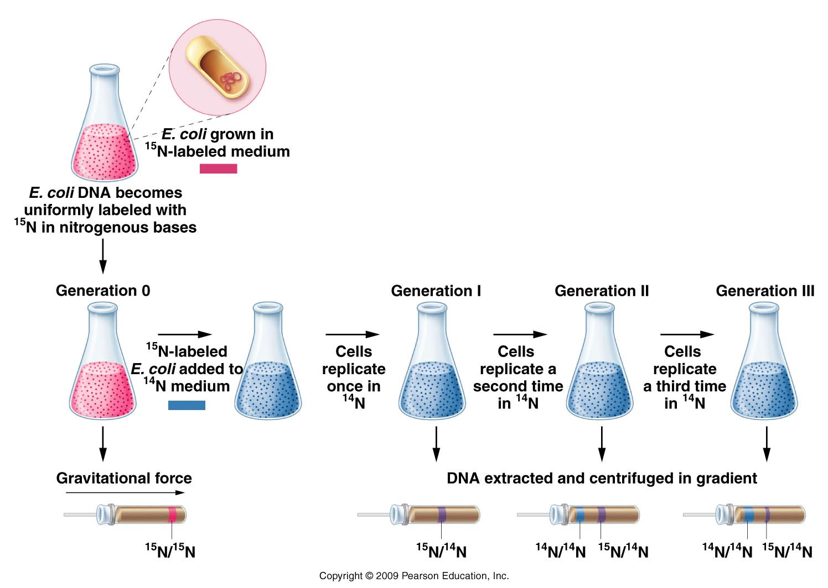
The Meselson-Stahl experiment
Figure 11.3
Notes:
Figure 11-3 The Meselson–Stahl experiment.

Slide 37
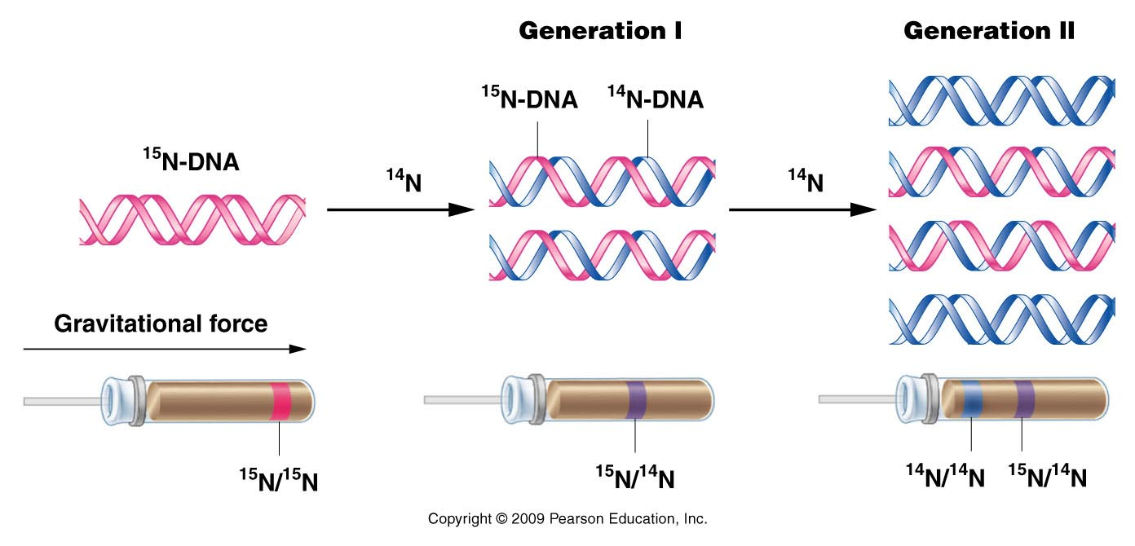
Figure 11.4
Notes:
Figure 11-4 The expected results of two generations of semiconservative replication in the Meselson–Stahl experiment.

Slide 38
Conclusion?
E. coli (and likely all bacteria) replicate their DNA via semiconservative mechanism.
What about Eukaryotes?

Slide 39
Taylor, Woods, Hughes experiment.
Used faba bean chromosomes and a more direct type of assay to test for semiconservative replication.

Slide 40
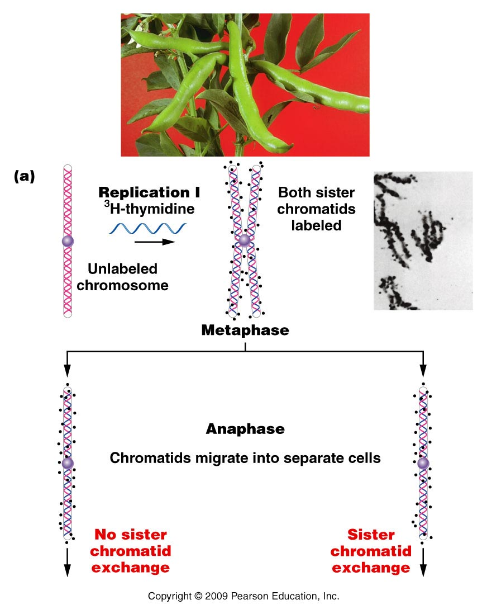
These experiments start with radioactive (“hot”) DNA ingredients
Dark grains indicate emission of radioactivity
Figure 11.5a
Notes:
Figure 11-5a The Taylor–Woods–Hughes experiment, demonstrating the semiconservative mode of replication of DNA in root tips of Vicia faba. A portion of the plant is shown in the top photograph. (a) An unlabeled chromosome proceeds through the cell cycle in the presence of 3H-thymidine. As it enters mitosis, both sister chromatids of the chromosome are labeled, as shown, by autoradiography. After a second round of replication (b), this time in the absence of 3H-thymidine, only one chromatid of each chromosome is expected to be surrounded by grains. Except where a reciprocal exchange has occurred between sister chromatids (c), the expectation was upheld. The micrographs are of the actual autoradiograms obtained in the experiment.

Slide 41
After one round of replication, if semiconservative replication occurs, one strand of each sister chromatid should be radioactive.
(Radioactivity in either/both strands is seen as dark spots)

Slide 42
These experiments start with radioactive (“hot”) DNA ingredients
Dark grains indicate emission of radioactivity
Figure 11.5a
Notes:
Figure 11-5a The Taylor–Woods–Hughes experiment, demonstrating the semiconservative mode of replication of DNA in root tips of Vicia faba. A portion of the plant is shown in the top photograph. (a) An unlabeled chromosome proceeds through the cell cycle in the presence of 3H-thymidine. As it enters mitosis, both sister chromatids of the chromosome are labeled, as shown, by autoradiography. After a second round of replication (b), this time in the absence of 3H-thymidine, only one chromatid of each chromosome is expected to be surrounded by grains. Except where a reciprocal exchange has occurred between sister chromatids (c), the expectation was upheld. The micrographs are of the actual autoradiograms obtained in the experiment.

Slide 43
When sister chromatids separate and get distributed to different cells in mitosis, those cells are allowed to replicate again, but in media that contains NO radioactive ingredients.

Slide 44
These experiments start with radioactive (“hot”) DNA ingredients
In each cell, if semiconservative replication took place only one strand of DNA is labeled.
Dark grains indicate emission of radioactivity
Figure 11.5a
Notes:
Figure 11-5a The Taylor–Woods–Hughes experiment, demonstrating the semiconservative mode of replication of DNA in root tips of Vicia faba. A portion of the plant is shown in the top photograph. (a) An unlabeled chromosome proceeds through the cell cycle in the presence of 3H-thymidine. As it enters mitosis, both sister chromatids of the chromosome are labeled, as shown, by autoradiography. After a second round of replication (b), this time in the absence of 3H-thymidine, only one chromatid of each chromosome is expected to be surrounded by grains. Except where a reciprocal exchange has occurred between sister chromatids (c), the expectation was upheld. The micrographs are of the actual autoradiograms obtained in the experiment.

Slide 45
Each chromosome is allowed to replicate a second time in unlabeled “cold” DNA ingredients. (only radioactive DNA from the first round will remain)
Figure 11.5b
Notes:
Figure 11-5b The Taylor–Woods–Hughes experiment, demonstrating the semiconservative mode of replication of DNA in root tips of Vicia faba. A portion of the plant is shown in the top photograph. (a) An unlabeled chromosome proceeds through the cell cycle in the presence of 3H-thymidine. As it enters mitosis, both sister chromatids of the chromosome are labeled, as shown, by autoradiography. After a second round of replication (b), this time in the absence of 3H-thymidine, only one chromatid of each chromosome is expected to be surrounded by grains. Except where a reciprocal exchange has occurred between sister chromatids (c), the expectation was upheld. The micrographs are of the actual autoradiograms obtained in the experiment.

Slide 46
Pulse-chase experiments
Use of isotopes and radiolabeling has been a great technique to follow the fate of biomolecules over time.
They are sometimes called “pulse-chase” experiments. The change in isotopes or change from radioactive (pulse) to non-radioactive (chase) shows where the the specific isotope goes.

